Slide 1
Middle States Commission on Higher Education (MSCHE): Reaccreditation
Process and Timeline
Spring 2024

Slide 2
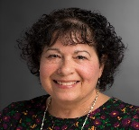
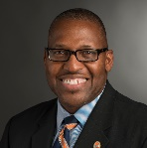
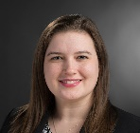
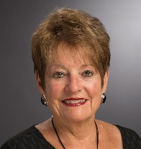
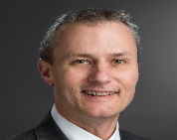
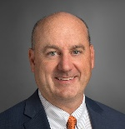
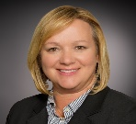
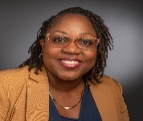
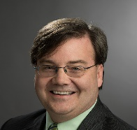
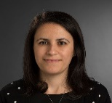
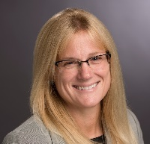
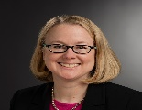
Steering Committee
Keith Jenkins, VP and Associ. Provost for Diversity, Equity and Inclusion
Karen Barrows, Chief of Staff, Office of the President
Michelle Snow, Director of Operations, Saunders College of Business (Student Government Representative)
Co-chairs
Melissa Masline, Assis. Director for Student Services, Saunders College of Business (Staff Council Representative)
Leah Bradley, Director of Educational Effectiveness
Christine Licata, Assessment Liaison Officer, Vice Provost for Academic Affairs
Jeffrey Wagner, Professor, Dept. of Economics, College of Liberal Arts
Bob Finnerty, Associate VP of University
Communications
Colleen Peterson, Assoc. VP for Enrollment Management
Larry Buckley, Associate Professor, Associate Dean, College of Science
Shelitha Williams, Assoc. VP for President for Student Development
Geremy Gersh, Associate CIO and Chief Technology Officer
,
Nilay Sapio, Director of Institutional Research, Data and Analytics
Risa Robinson, Professor, Dept. Chair of Mechanical Engineering, Kate Gleason College of Engineering
Kim VanGelder, Chief Information Officer and Senior VP, Eastman Kodak Company (Board of Trustees representative)
Cathy Hain Associate VP for University Advancement
Kathryn Schmitz, Associate Professor, Dept. Chair of Liberal Studies, NTID

Slide 3
Reaccreditation Overview
Middle States (MSCHE) is a major accreditation event
Title IV funds depend on accreditation
RIT’s last accreditation visit was 2017
Comprehensive Institutional Self-Study occurs (Spring 2024 to Jan 2026)—Narrate RIT’s story!
External evaluation team will visit Henrietta campus and 2 to 3 global locations ( Early Spring 2026)
Self-Study focus: 7 accreditation standards, 3 institutional priority focus areas, 4 self-study outcomes
Steering Coimmittee and Working Groups (7-10) collect/analyze data, make recommendations and prepare self-study report

Slide 4
Revised Standards (Approved 2023)
Mission and Goals
Ethics and Integrity
Design and Delivery of Student Learning Experience
Support of the Student Experience
Educational Effectiveness Assessment
Planning, Resources, & Institutional Improvement
Governance, Leadership & Administration

Slide 5
2023-24
Form Steering Committee and Working Groups
2024-25
Gather data evidence
Write and revise Self-Study drafts
2026
Submit final Self-Study
Submit Self-Study Design
Team Chair Visit
MSCHE Vice President Visit
External Team Visit to Henrietta and 2-3 global campuses
RIT Response and Final Action

Slide 6
2023-24
2024-25
2026
Nov 15, 2023 Appoint Steering Committee Members (SC)
Feb 28, 2024 Select Working Groups (WC)
April 1, 2024 Prepare Draft Self-Study Design
April - Sep, 2024 Self-Study Preparation Visit by MSCHE Vice President
Sep 2024 Working Groups Begin Inquiry
Sep 2024 - May 2025 SC and WG Collect Data Evidence
Aug/Oct 2025 Self-Study Draft #1 Finalized
Nov 2025 Campus Feedback on Draft #1
Dec 2025 Feedback on Self-Study Draft #2
Nov/Dec 2025 External Team Chair Visit to RIT
Jan 2026 Further Revisions to Self-Study Draft
Feb 2026 Final Self-Study Report
March/April 2026 Evaluation Team Visit
May 2026 RIT’s Response to Evaluation Team’s Findings
June 2026 MSCHE: Final Accreditation Action Taken

Slide 7
Goals of the Self-Study
First three are prescribed by MSCHE. Fourth is proposed by steering committee.
Meet the Standards: Demonstrate how the institutions currently meets the Commission’s Standards for Accreditation and Requirements for Affiliation
Continuous Improvement: Focus on continuous improvement in the attainment of the institution’s mission and its official priorities
Engage Institutional Community: Engage the institutional community in an inclusive and transparent self-appraisal process that actively and deliberately seeks to involve members from all areas of the institutional community.”
Inform Strategic Plan: Capitalize on overlapping efforts to develop the institution’s new Strategic Plan and the self-study to advance our strategic priorities, identify gaps in the readiness to implement such priorities and recommend opportunities to achieve institutional mission and goals

Slide 8
Priorities for Consideration:Guide Self-Study
Improve Student Success
Expand our Research Enterprise
Choose ONE
Build, Enhance and Infuse Diversity, Equity and Inclusion into all Aspects of the University Enterprise
Prioritize Well-Being into RIT’s Campus Culture
Ensure Experiential Learning beyond the Classroom

Slide 9
Choosing the Priorities
Priorities are informed by strategic plan and mission statement
SC drafted six priorities and presented to president and provost
Incorporated feedback from president and provost and drafted five priorities for consideration
Qualtrics Survey to gather feedback from governance groups and Board of Trustees
Student Government Provost’s Council
Staff Council President’s Cabinet
Faculty Senate
The first task is to choose three institutional priorities that will guide the self-study.

Slide 10
Thank You

Slide 11
Guiding Principles
Application of the Standards within the Context of an Institution’s Mission and Goals
Centrality of the Student Experience
Reflection on Diversity, Equity, and Inclusion
Emphasis on Data and Evidence-based Decision-making
Innovation as an Essential Part of Continuous Improvement
Five principles guide the analysis in each of the seven standards because of their importance in higher education.

