Slide 1
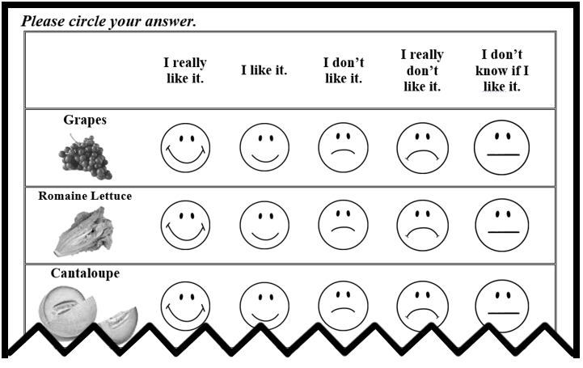
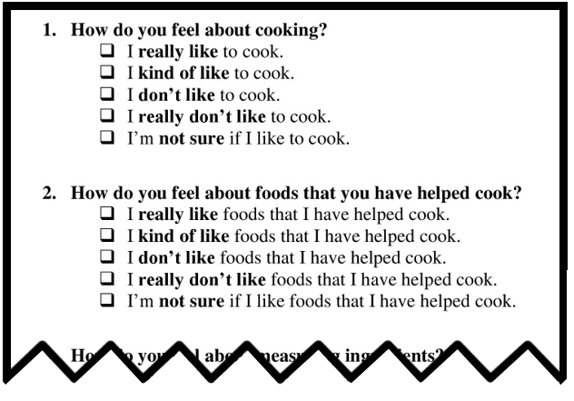
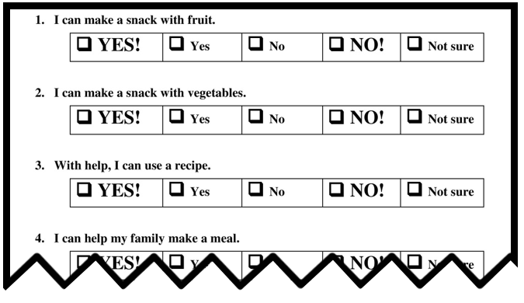
Fuel for Fun child assessments of vegetable preferences
and cooking self-efficacy show predictive validity
with targeted Healthy Eating Index components
Leslie Cunningham-Sabo¹, Melissa Pflugh Prescott¹, Diane Mitchell², Barbara Lohse³
¹Colorado State University, ²The Pennsylvania State University, ³Rochester Institute of Technology
Abstract
Results
Purpose: Improving children’s dietary behavior through cooking interventions is gaining popularity, yet effect of these resource-intensive strategies is largely unknown because of few valid impact measures. We examined the ability of fruit and vegetable preferences (FP, VP, FVP), cooking attitudes (AT) and self-efficacy (SE) assessments to predict Healthy Eating Index (HEI) scores among 4th-graders.
Methods: 1,409 children participating in Fuel for Fun, a school-based culinary intervention, completed classroom-administered baseline surveys: FVP (18 items, range 18 – 90), FP (7 items, range 7 – 35), VP (11 items, range 11 - 55), AT (6 items, range 6 – 30), and SE (8 items, range 8 – 40). A subset (n=101) completed 2 or 3 24-hour dietary recalls (diet assessments, DA) via telephone interview to obtain HEI scores. Bootstrapped linear regressions were used to examine predictive validity of FP, VP, AT and SE for targeted HEI components. Sex and a categorical variable for race/ethnicity were included as a priori controls in each regression model. Each model was run a second time with the inclusion of BMI z-score as a covariate.
Results: DA (mean age 9.1 + 0.4 y; 47% female, 78% white, 17% overweight/obese) and non-DA children did not differ except for lower DA BMI percentile (49.4 + 30.8 vs. 57.1 + 30.0, P<0.01). Total HEI scores (maximum 100) ranged from 33.8 – 91.1, mean 63.8 + 10.9. HEI component mean scores (maximum 5) were: whole fruit 3.6 + 1.7; total vegetables 3.7 + 1.6; greens and beans 1.4 + 1.8; and empty calories (maximum 20) 18.6 + 2.4. FP mean was 29.3 + 4.5, VP was 36.6 + 8.2, cooking AT was 26.1 + 3.4, and SE was 33.9 + 5.8. No HEI or survey scores differed by gender except HEI whole fruit was greater in boys (P=0.04). VP predicted HEI total score, total vegetables, and greens and beans in anticipated direction (p<0.05); cooking SE was positively associated with HEI total score (p<0.05) and whole fruit (p=0.05). FP and AT were not associated with HEI total or component scores.
Conclusions: Vegetable preference and cooking self-efficacy predicted HEI total and many FV component scores, supporting validity of Fuel for Fun outcome measures.
Child participants were predominately white, Non-Hispanic and on average had a healthy weight (mean BMI percentile 49.4 + 30.84), similar to earlier samples.⁶ Total HEI scores (possible range 0 -100) ranged from 33.8 – 91.1, and on average suggested high diet quality. No HEI or survey scores differed by gender, except HEI whole fruit was greater in boys (p=0.04) (Table 1).
Table 1. Characteristics of Fourth-Grade Students
Variable | n | (%) |  | Variable | n | Mean | ± | SD
Female | 47 | (46.5) |  | Age (years) | 101 | 9.1 | ± | 0.4
Ethnicity | 101 |  |  | Fruit and Vegetable Preference | 98 | 65.6 | ± | 11.3
White | 79 | (78.2) |  | Fruit Preference | 101 | 29.1 | ± | 4.5
Hispanic | 13 | (12.8) |  | Vegetable Preference | 98 | 36.4 | ± | 8.0
Black | 1 | (1.0) |  | Cooking Attitude | 101 | 26.0 | ± | 3.4
Asian | 3 | (3.0) |  | Cooking Self-Efficacy | 100 | 33.7 | ± | 5.9
American Indian | 2 | (2.0) |  | Healthy Eating Index – 2010 (HEI) | 101 | 62.5 | ± | 10.7
Two or more races | 3 | (3.0) |  | Total Whole Fruit Component | 101 | 3.6 | ± | 1.6
BMI Category | 93 |  |  | Total Vegetable Component | 101 | 2.3 | ± | 1.5
Underweight | 5 | (5.4) |  | Total Greens and Beans Component | 101 | 1.3 | ± | 1.7
Healthy Weight | 72 | (77.4) |  | Total Empty Calories Component | 101 | 18.8 | ± | 2.0
Overweight | 5 | (5.4)
Obese | 11 | (11.8)
SD= Standard Deviation, BMI= Body Mass Index
Introduction
VP predicted HEI total score, total vegetables, and greens and beans in anticipated direction (p<0.05), but the relationship between VP and total vegetables only trended towards significance once BMI z-score was added to the model (p= .09; Table 2). Each additional 2 point increase in cooking SE was associated with a 1.33 point HEI Score increase (b= 0.667, p=0.003). Cooking SE also predicted total vegetables (p= 0.008) and whole fruit (p= 0.031). The associations between cooking SE and HEI score and whole fruit persisted when BMI z-score was controlled. Cooking SE also predicted total vegetables (p=0.008) but only trended toward significance in Model 2 (p=0.059). The relationships between Fuel for Fun survey items and targeted HEI components were consistent under logistic regression analysis. Also, an additional 3 point increase in VP increased the odds of meeting whole fruit consumption recommendations by 30.9% (OR= 1.309, 95% CI: 1.074, 1.598). FP and AT did not significantly predict HEI total or component scores.
Children’s involvement in home cooking is associated with healthful dietary behaviors,^{1,2} yet few U.S. parents are cooking at home³
Additionally, there are few in-school cooking opportunities for U.S. elementary students
Assessing children’s dietary intake is important, yet resource and time intensive
There are also few tools to assess the impact of cooking interventions on children’s dietary intake and quality
Fuel for Fun: Cooking with Kids Plus Parents and Play is a cooking-focused, classroom-based intervention to improve 4th-grade student’s dietary attitudes and behaviors by increasing their interest and skills in preparing and tasting a wide variety of fruit and vegetable-rich dishes⁴
The purpose of this study was to determine the ability of Fuel for Fun’s tested fruit and vegetable preferences (FP, VP), cooking attitudes (AT) and self-efficacy (SE) assessments to predict Healthy Eating Index (HEI) scores among 4th-graders.
Table 2. Linear Regression Results from 5,000 Bootstrap Samples
 | Model 1ª |  | Model 2^{b}
 | b | SE(b) | b | SE(b)
Healthy Eating Index – 2010 (HEI)
Fruit and Vegetable Preference^{c} | 0.172 | 0.092 | 0.178 | 0.109
Fruit Preference^{d} | -0.107 | 0.232 | -0.179 | 0.283
Vegetable Preference^{c} | 0.361 | 0.129 | 0.392 | 0.153
Cooking Attitude^{d} | 0.648 | 0.353 | 0.609 | 0.398
Cooking Self-Efficacy^{e} | 0.595 | 0.172 | 0.667 | 0.209
HEI Whole Fruit Component
Fruit and Vegetable Preference | 0.023 | 0.014 | 0.021 | 0.016
Fruit Preference | 0.036 | 0.036 | 0.019 | 0.039
Vegetable Preference | 0.033 | 0.020 | 0.034 | 0.022
Cooking Attitude | 0.099 | 0.052 | 0.091 | 0.057
Cooking Self-Efficacy | 0.061 | 0.029 | 0.070 | 0.035
HEI Total Vegetable Component
Fruit and Vegetable Preference | 0.032 | 0.012 | 0.024 | 0.014
Fruit Preference | 0.055 | 0.029 | 0.039 | 0.034
Vegetable Preference | 0.044 | 0.017 | 0.034 | 0.020
Cooking Attitude | 0.034 | 0.045 | 0.015 | 0.046
Cooking Self-Efficacy | 0.059 | 0.022 | 0.052 | 0.027
HEI Greens and Beans Component
Fruit and Vegetable Preference | 0.032 | 0.014 | 0.030 | 0.017
Fruit Preference | 0.008 | 0.037 | 0.009 | 0.042
Vegetable Preference | 0.060 | 0.019 | 0.054 | 0.023
Cooking Attitude | -0.014 | 0.056 | -0.022 | 0.062
Cooking Self-Efficacy | 0.028 | 0.025 | 0.014 | 0.032
HEI Empty Calories Component
Fruit and Vegetable Preference | 0.028 | 0.024 | 0.018 | 0.026
Fruit Preference | 0.019 | 0.050 | -0.028 | 0.047
Vegetable Preference | 0.049 | 0.036 | 0.043 | 0.041
Cooking Attitude | 0.034 | 0.068 | 0.024 | 0.066
Cooking Self-Efficacy | 0.133 | 0.058 | 0.120 | 0.070
ª Adjusted for race/ethnicity and gender ^{b} Adjusted for race/ethnicity, gender, and BMI z-score ^{c} For all outcomes: Model 1 n=98, Model 2 n=90 ^{d} For all outcomes: Model 1 n=101, Model 2 n=93 ^{e} For all outcomes: Model 1 n=100, Model 2 n=92 Bold indicates statistical significance with p < 0.05 b= Regression Coefficient, SE= Standard Error, BMI= Body Mass Index
Methods
All data were collected at study baseline. Data consisted of three 24-hour dietary recalls collected by telephone over a 2-4 week period by trained interviewers using a standard protocol.⁴ Data were collected using Nutrition Data System for Research software version 2013 and 2014. Interviews were conducted with the parent present in most cases, and lasted about 15 to 20 minutes. Calls were unannounced, with a goal of obtaining 2 weekday and 1 weekend dietary recalls. Only students with > 2 dietary recalls were included in this study.
Fruit and Vegetable Preference:
18 items, possible score 18 – 90
Cooking Attitude Questions:
6 items, possible score 6 – 30
4th grade students taking the Fuel for Fun survey
Child FVP, FP, VP, AT, SE, age, sex and race/ethnicity were collected with the Fuel for Fun survey, using a standardized administration protocol. All items were previously confirmed for face and content validity and test-retest reliability.⁵ Height and weight data were measured by trained personnel on the same day as survey administration.
Bootstrapped linear regressions examined the predictive validity of FV preference, FP, VP, cooking AT and cooking SE for targeted HEI components (HEI Score and the following HEI components: Whole Fruit, Total Vegetables, Green Vegetables & Beans, and Empty Calories). The large number of student HEI values at the upper and/or lower bounds supported the use of logistic regressions to confirm the relationships between Fuel for Fun survey items and targeted HEI components. Sex and a categorical variable for race/ethnicity were included as a priori controls in each regression model. Each model was run a second time with the inclusion of BMI z-score as a covariate because it was a confounder.
Cooking Self-Efficacy Questions:
8 items, possible score 8 – 40
Conclusions
Vegetable preference and cooking self-efficacy scores predicted HEI scores and some HEI component scores demonstrating construct and criterion validity of Fuel for Fun outcome measures.
Results also reinforce the relationship between cooking and healthful dietary behavior.
References
Acknowledgements
1. Chu, Y.L., Farmer, A., Fung, C., Kuhle, S., Sorey, K.E., & Veugelers, P.J. (2013). Public Health Nutrition. 16(1), 108-112.
2. Nozue, M., Ishida, H., Hazano, S., et al. (2016). Nutrition Research and Practice. 10(3), 359-363.
3. Cunningham-Sabo, L. & Simons, A. (2012). Nutrition Today. 47(3), 128-132.
4. Cunningham-Sabo, L., Lohse, B., et. al. (2016). BMC – Public Health. 16,444.
5. Lohse, B., Cunning-Sabo, L., Walters, L.M., Stacey, J.E. (2011). J of Nutrition Education and Behavior. 43(1), 42-49.
6. Cunningham-Sabo, L., Lohse, B. (2013). Childhood Obesity. 9(6), 549-556.
This material is based upon work supported by the National Institute of Food and Agriculture, U.S. Department of Agriculture, under award number 2012-68001-19603. Any opinions, findings, or recommendations in this publication are those of the authors and do not necessarily reflect the view of the U.S. Department of Agriculture.

