Slide 1
3D Printing:
How does it Work?
Toyota Production Systems Lab
Grade K-5

Slide 2
3D Printing
3D Printing is about utilizing a printer that builds a part or an object from the ground up, one layer at a time.
It adds one layer on top of another…like a cake!
Using computer software, it can print ideas in 3 Dimensions!

Slide 3
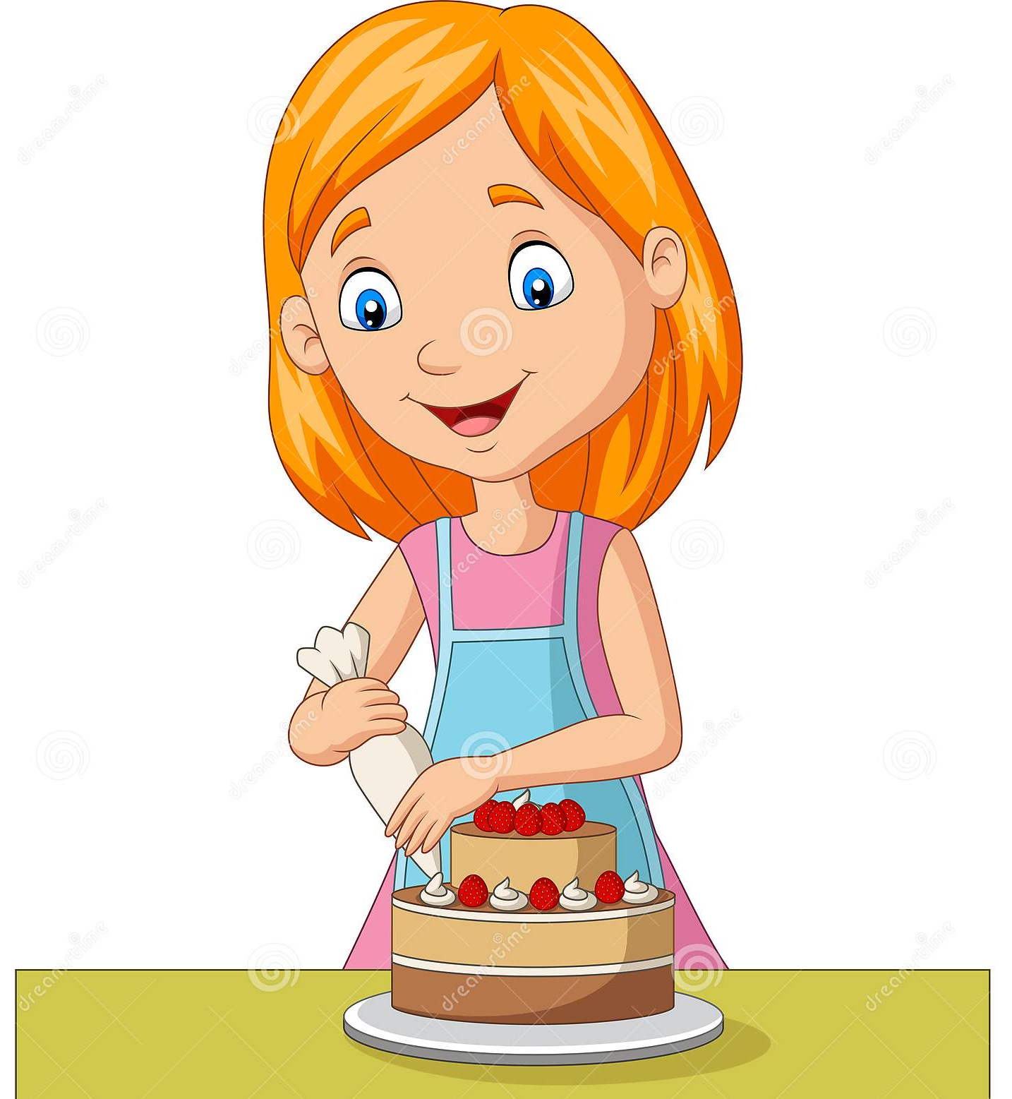
How does 3D Printing Work?
It can be pretty tricky to figure out how a 3D Printer works, so let’s make it easier by relating it to something sweet…making a cake!

Slide 4
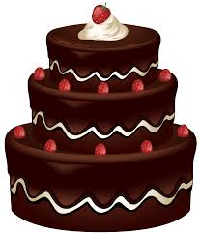
3D Printing Like Making a Cake
When you bake a cake, you bake multiple layers then one by one stack one on top of the other.
3D Printing does the same thing! It prints one layer and then stacks the layers on top of each other.
With cake we use frosting to stick the layers to one another
3D Printers print hot material which is soft so each layer sticks

Slide 5
After we layer, the Cake we Decorate!
3D Printing prints material exactly like how frosting comes out of a decorating pipe! The material is pushed through the pipe called an extruder and controlled by the machine to make sure it is piped in the right spot.

Slide 6
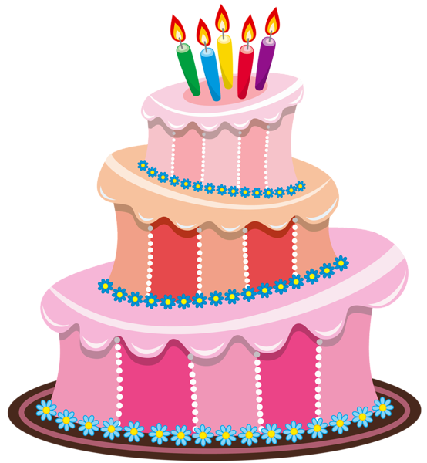
Activity
Let’s make a cake the 3D Printing Way!
Now that we know that making a cake and 3D Printing are the same, lets remember the key words we use when we talk about 3D printing a decorate our delicious cake!

Slide 7
What We Learned
3D Printing is just like making a cake! It creates a layer of material and adds one layer on top of another to make a final product.

