Slide 1
Robots in Manufacturing
STEM & Industrial Engineering
Toyota Production Systems Lab
Robotics: Grades K-5

Slide 2
These are all areas of Industrial Engineering. Where do robots & robotics fit in this?
Industrial Engineering!

Slide 3
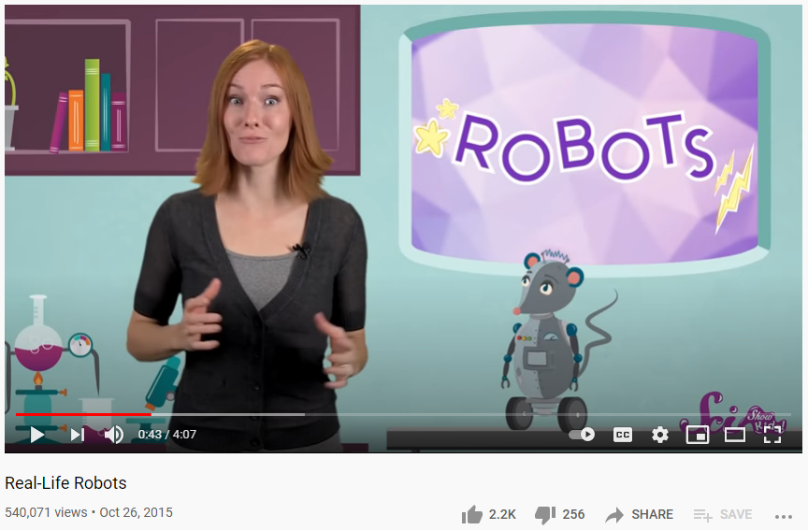
So what are robots?
A robot is a machine capable of doing many difficult actions automatically, and is programmable by a computer. Robots are also not just the ones you see in movies!
Click on the image to watch the video!

Slide 4
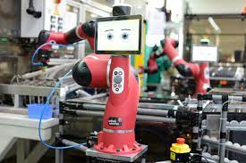
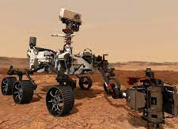
So what are robots in manufacturing?
Robots in manufacturing can take on repetitive tasks, which streamlines overall assembly workflow
Robots also collaborate with humans for product production
Many jobs are dangerous or include high volumes of materials, which can be harmful to human workers, so the robots can help out!
Robots also help productivity in time it takes to complete tasks & take the load off human workers for other tasks
Perform tasks such as: welding, assembly, shipping, handling raw materials, and product packing!
Notes:
https://mantec.org/robotics-manufacturing/#:~:text=Robots%20are%20used%20in%20manufacturing,be%20harmful%20to%20human%20workers.

Slide 5
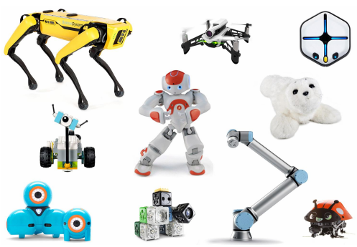
Today’s Activity!
Explore the world of robots!
Notes:
https://robots.ieee.org/learn/activities/robots-activity-sheets.pdf from https://robots.ieee.org/learn/activities/
Older kids: design a robot based on situation

Slide 6
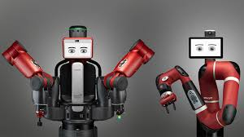
These steps come from our worksheet provided, which you will use after to check your answers!
Our activities today build on concepts from IEEE Robots
You will need a piece of paper and pen or pencil to complete!
There will be some activities we won’t do here, so feel free to do them on your own for fun after today’s presentation!
Here is an example robot like the ones we will talk about today:
This is called a Cobot!
These are used in manufacturing and test facilities to help workers in production, and give people a collaborative touch

Slide 7
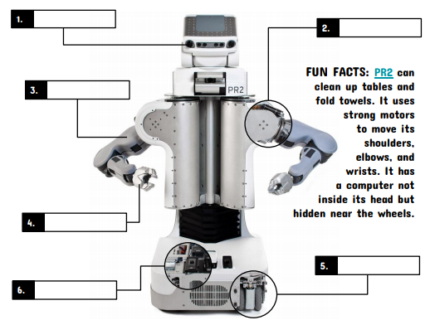
Step 1: Robot parts - use the list to label the PR2 robot
Analysis:
Why do you think a robot has these parts?
If the robot’s goal is to help with household chores, what is something you would add that would allow the robot to do a new chore?

Slide 8
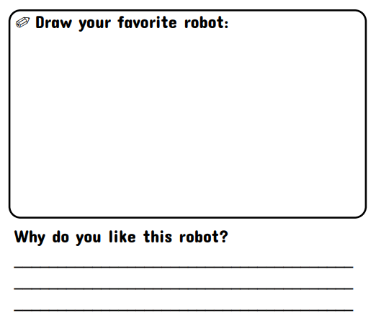
Step 2: Improving the PR2 Robot
-Using your answers from step 1, draw your robot with the new parts you would like included to include a new chore job you’ve given it!

Slide 9
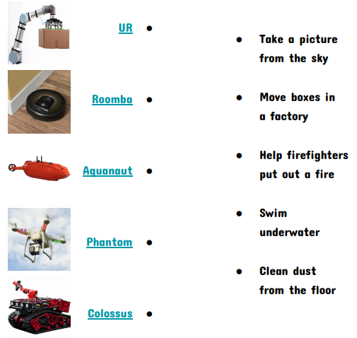
Step 3: Robot jobs - connect the robot on the left to the job you think it does
Analysis:
Based on these examples of jobs robots can do, would you say robots are important?
Explain why!

Slide 10
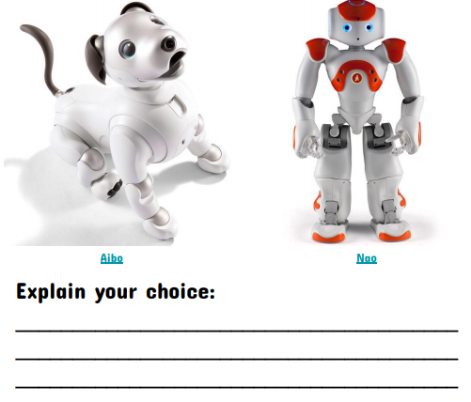
Step 4: Robot face off! Which of the robots below would you want to have?
Analysis:
What are 3 things you think the robot you picked can do?
1.
2.
3.

Slide 11
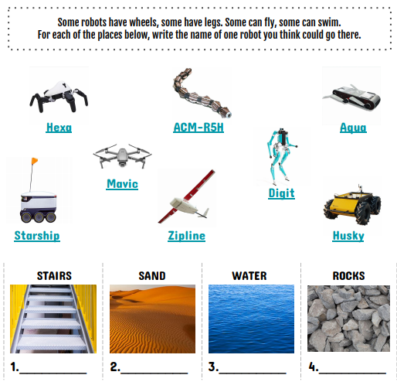
Step 5: How do robots move?
Analysis:
Do you think some of these robots can move in more ways than one? Which robots?
If you were to make a robot that could move in all of these places, what would it need to move?

Slide 12
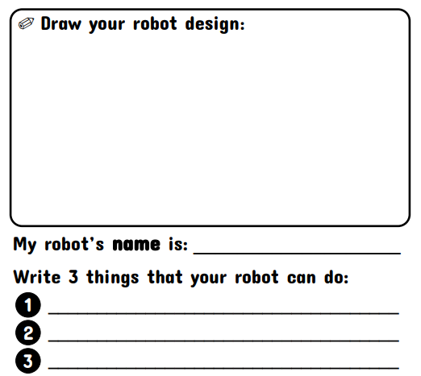
Step 6: Create your own robot!
Now that you’ve learned about robots, think of a reason you would need a robot. Draw that robot below!

Slide 13
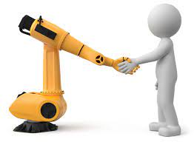
Step 7: Reflection: answer the questions about today’s activity
What do you like or dislike about this technology?
List here:
Likes: Dislikes:
1] 1]
2] 2]
3] 3]
Do you think that robots are important to helping people?
How would you make the activity better?

Slide 14
Congratulations!
You have learned about robots in manufacturing!

Slide 15
Thank you!

