Slide 1
Reframing General Education @ RIT
September 13, 2024

Slide 2
Agenda
Vision for General Education (Prabu)
Current GE Framework Overview and MSCHE Self-Study(Chris)
GEC Recommendations (Bill Middleton or other GE Member)
Taskforce Charge (Prabu)
Advisory Group Role (Prabu)
Timeline (Prabu)
This Photo by Unknown Author is licensed under CC BY-NC-ND

Slide 3
Provost’s Vision
This Photo by Unknown Author is licensed under CC BY-NC-ND

Slide 4
GE Revision and MSCHE Self Study
Std 3: Design and Delivery of Student Learning Experience
Criteria 5: At institutions that offer undergraduate education, a general education program, free standing or integrated in to academic disciplines that:
a. Offers a sufficient scope to draw students into new areas of intellectual experience, expanding their cultural and global awareness and cultural sensitivity and preparing them to make well-reasoned judgments outside as within their academic field;
b. Offers a curriculum designed so that students acquire and demonstsrate essential skills including at least oral and written communication; scientific and quantitative reasoning, critical analysis and reasoning;, technological competency and information literacy. Consistent with mission, the general education also includes the study of values, ethics and diverse perspectives.

Slide 5
Current Gen Ed Framework and Outcomes
Outcomes: Each GE Course to include one of these outcomes; First Year Writing Course required and 2 Writing Intensive Courses
Communication | Express oneself effectively in common college-level written forms Revise and improve written products Express oneself effectively in presentations, either in American English or American Sign Language Demonstrate comprehension of information and ideas accessed through reading
Critical Thinking | Use relevant evidence gathered through accepted scholarly methods and properly acknowledge sources of information Analyze and construct arguments considering their premises, assumptions, contexts, and conclusions, and anticipating counterarguments Reach sound conclusions based on logical analysis of evidence Demonstrate creative and/or innovative approaches to assignments or project
Perspective Domains: Requirements differ by degree type
Ethical | Identify contemporary ethical questions and relevant positions
Artistic | Interpret and evaluate artistic expression considering the cultural context in which it was created
Global | Examine connections among the world’s populations
Social | Analyze similarities and differences in human experiences and evaluate the consequences
Natural Science Inquiry | Demonstrate knowledge of basic principles and concepts of one of the natural sciences AND Apply methods of scientific inquiry and problem solving to contemporary issues
Scientific Principles | Demonstrate knowledge of basic principles and concepts of on of the natural sciences OR Apply methods of scientific inquiry and problem solving to contemporary issues
Mathematical | Comprehend and evaluate mathematical or statistical information AND Perform college-level mathematical operations or apply statistical techniques

Slide 6
Gen Ed Curriculum: 60 or 30 credit hours (BS or BFA)
Perspective Courses:
BS: 8 perspective courses: One course from all categories and 2 courses from Mathematical category
BA: 5 perspective courses: ethical, artistic, global and social + one from either of the remaining categories (Math/Science)
Immersions: One required (Series of 3 courses connected to a discipline or theme)

Slide 7
Gen Ed @ RIT Overview
Students in BS degree programs are required to complete at least 60 credit hours of GE, students in BFA programs are required to take 30 credit hours of GE.
Undergraduate courses from all academic units can be included in the GE curriculum. Courses must meet NYSED’s definition of Liberal Arts and Sciences.
GE courses (1000+ offered in 8/9 Colleges/Degree Granting Units) are mapped to GE SLOs and approved by the General Education Committee (GEC).

Slide 8
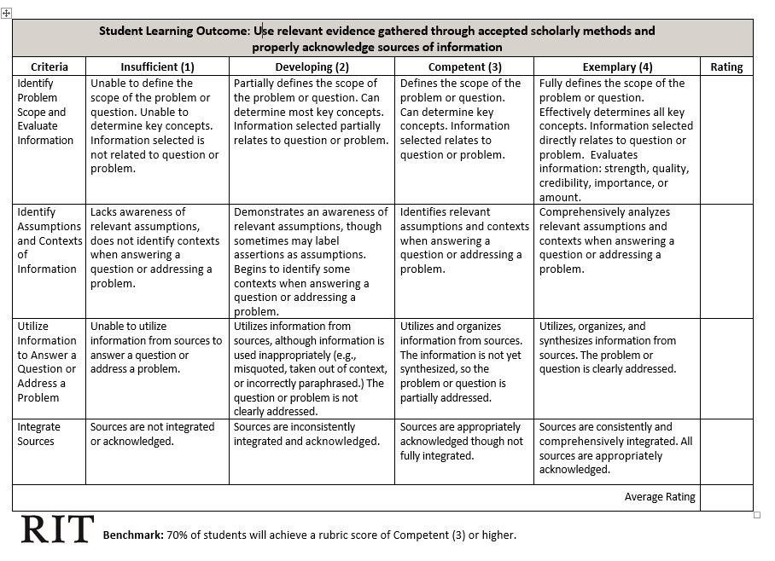
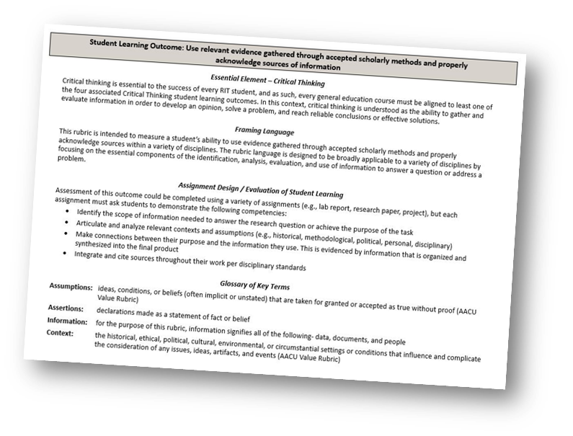
Gen Ed Assessment
The Office of EEA maintains a schedule for assessing RIT’s 16 Gen Ed SLOs
Approved General Education courses provide the assessment opportunities
Revision provides opportunity for an updated assessment plan

Slide 9
General Education Committee (GEC)
Recommendations

Slide 10
GEC recommends that RIT revisit and revise the GE Framework. The Rationale is:
Too many learning outcomes, leading challenges in teaching and assessing all outcomes;
The current model has translated into a “box-checking” model for students;
Students have indicated that they would like more flexibility and choice;
The framework should include modern issues (e.g. social justice, sustainability)
We are missing a marketing and recruitment opportunity;
We should provide a common learning experience in the first year;
Lack of cohesion of experience: GE curriculum is not integrated into the broader learning experience.

Slide 11
Revision Goals
Align the curriculum with student interests and expectations
Create an exciting and uniquely RIT GE experience that we can market to incoming students
Facilitate meaningful assessment of GE learning outcomes

Slide 12
Core Task Force/Advisory Group Responsibilities
Core Taskforce:
Research existing models
Develop proposed model/framework
Develop a communication plan
Gain Consensus
Develop Implementation Plan
Advisory Group:
Provide ongoing consultation, as needed
Meet once per semester to review plans and provide feedback

Slide 13
Revision Timeline: This is Very Aggressive
AY 2024- 2025
Research frameworks at comparable/competitive schools
Revise framework, learning outcomes
Develop proposal to present to stakeholders—
All work should be included in the MSCHE Self-Study: Standard 3 Chapter
AY 2025- 2026
Share proposal with stakeholders and build consensus
Prepare plan for implementation—consider staged implementation?
AY 2026-27
Begin Implementation (or continue planning for implementation to occur in next academic year)

Slide 14
Stakeholders
Students/Student Government
Senior Leadership
Faculty Senate
Academic Colleges
Registrar
College Advisors
Enrollment Management
Undergraduate Admissions
Marketing & Communications
Board of Trustees

Slide 15
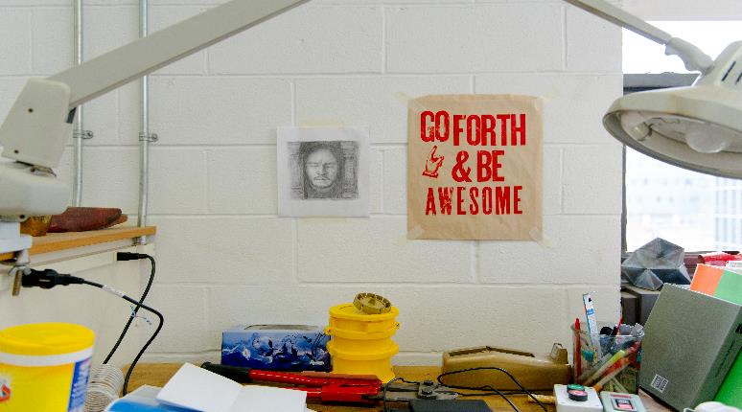
Questions/Discussion

