Slide 1
5 Minute Rubrics
Fall Symposium

Slide 2
Why Rubrics?
Consistence and Fairness
Clear Expectations
Constructive Feedback
Efficiency in Grading

Slide 3
ChatGPT
Efficiency: Saves time for instructors by generating draft rubrics based on assignment criteria.
Clarity: Helps ensure rubrics are comprehensive and easy for students to understand.
Customization: Rubrics can be tailored quickly for different levels and learning outcomes.

Slide 4
Benefits
For Instructors:
Productivity: Reduces the workload of rubric development, allowing more time for other instructional activities.
Consistency: Creates consistent and well-structured rubrics across courses.
For Students:
Transparency: Clear expectations lead to a better understanding of grading criteria.
Fairness: Rubrics developed with AI ensure consistent grading.

Slide 5
What you will learn
How to prompt ChatGPT effectively to generate rubrics tailored to your courses.
Techniques for refining AI-generated rubrics to match specific educational goals.
Best practices for integrating these rubrics into your course management system.

Slide 6
Prompting is key
Clearly Describe the nature of the assignment.
Identify the key criteria you want in the rubric.
Specify the number of performance levels.
Ask ChatGPT to include concrete and measurable descriptions for each criterion to ensure clarity.

Slide 7
Specify the Assignment
Clearly describe the nature of the assignment. Include the type (e.g., essay, lab report, presentation), length, and any specific requirements.
Example: "Generate a rubric for a 5-page research essay in a Systems Administration course."

Slide 8
Define the Learning Outcomes
Mention the learning objectives or skills you want to assess.
Example: "The rubric should assess critical thinking, use of credible sources, technical accuracy, and organization."

Slide 9
List the criteria
Identify the key criteria you want in the rubric, such as content, analysis, presentation, or adherence to guidelines.
Example: "Include criteria such as technical detail, structure, clarity, and depth of research."

Slide 10
Indicate Performance Levels
Specify the number of performance levels (e.g., Exemplary, Proficient, Needs Improvement) and describe what distinguishes each level.
Example: "Create four performance levels with detailed descriptions for each."

Slide 11
Request Specific details
Ask ChatGPT to include concrete and measurable descriptions for each criterion to ensure clarity.
Example: "Make sure the descriptions are measurable, such as 'uses at least five credible sources' or 'demonstrates a clear and logical argument.'"

Slide 12
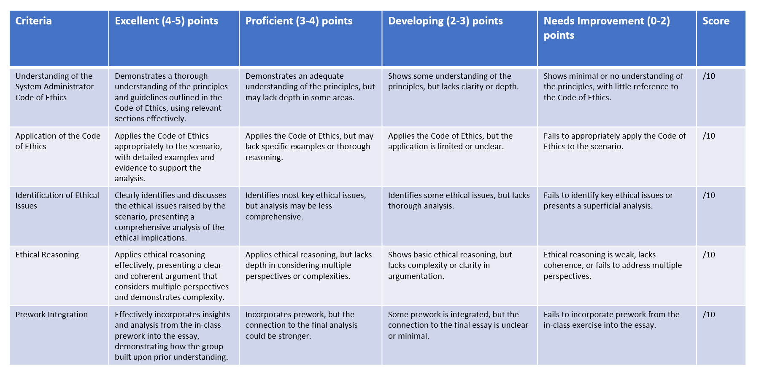

Slide 13
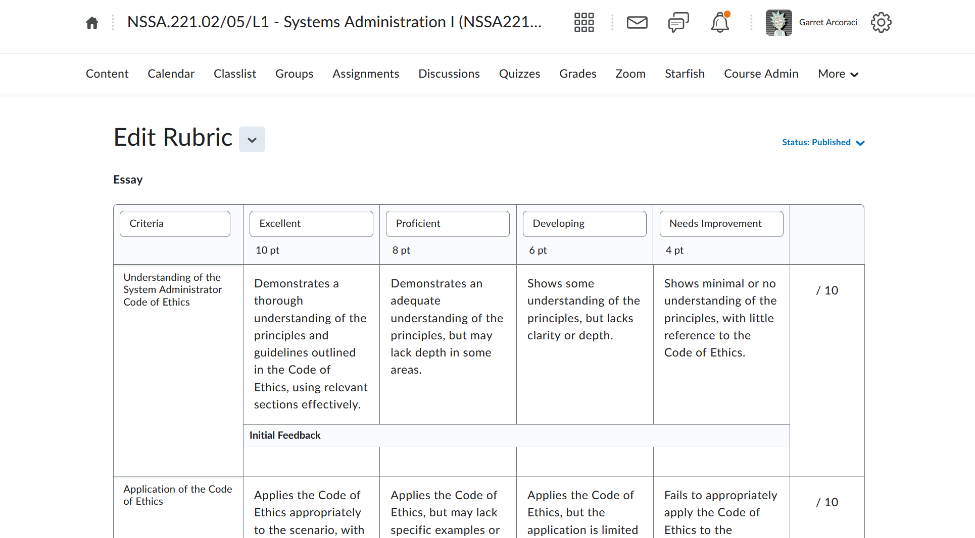

Slide 14
Let’s rubric!
Demonstration
SHED, Room 3350
Table 3

