Slide 1
ProGenie –
Problems to Enhance Student Engagement
AI Hub Symposium
November 1, 2024

Slide 2
ProGenie – A Problem Generation Tool
The Faculty Teaching Role…
Creating learning experiences
Curating information students need (different representations)
Coaching students through those learning experiences
Notes:
Primarily Exploring these 9 Majors

Slide 3
ProGenie – A Problem Generation Tool
What does ProGenie do?
Quickly creates a discipline-specific problem aligned with faculty-supplied parameters.
Generates problem statement, solution, and rubric
Supports rapid generation of a wide variety of problems geared to specific learning objectives
Notes:
Primarily Exploring these 9 Majors

Slide 4
ProGenie – A Problem Generation Tool
What problem are we solving (i.e. “why?”)?
Easily create problems that are meaningful to students
Provide student autonomy in problem selection
This semester…
Helping CET Calculus students connect calculus and the various engineering disciplines.
Notes:
Primarily Exploring these 9 Majors

Slide 5
ProGenie – A Problem Generation Tool
Example Scenarios
Packaging Science grade compression failure load
Aeronautical controls problem for mechatronics engineers
Biomechanics problem for mechanical engineers focused on angular momentum
Notes:
Primarily Exploring these 9 Majors

Slide 6
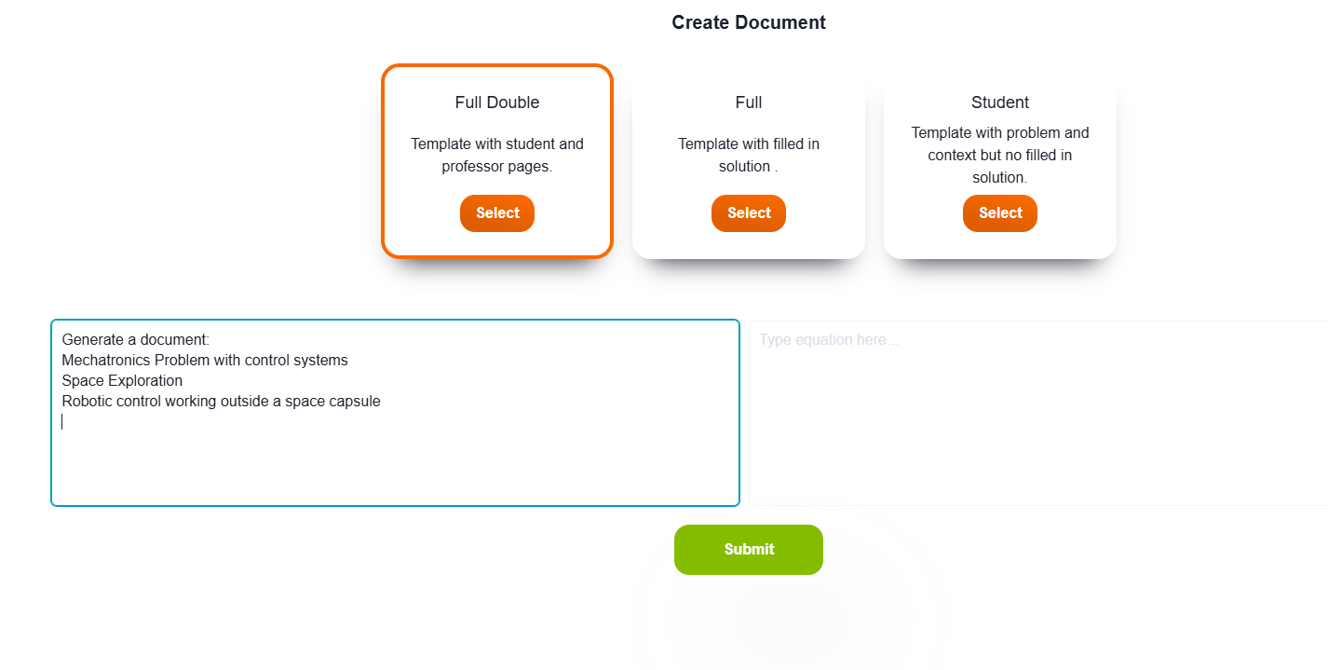
ProGenie
Notes:
Primarily Exploring these 9 Majors

Slide 7
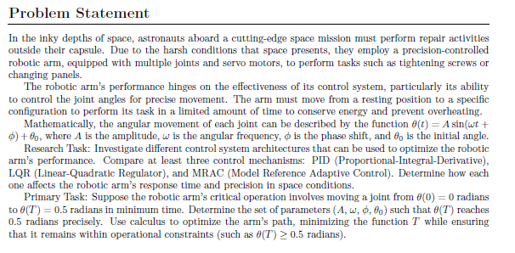
ProGenie
Notes:
Primarily Exploring these 9 Majors

Slide 8
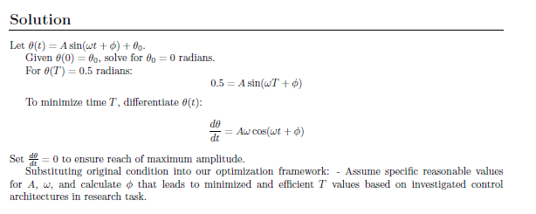
ProGenie
Notes:
Primarily Exploring these 9 Majors

Slide 9
Thank you!

